Slide 1



MERN – ES6 + React
Module 13: React

Slide 2
Outline
Module 13
HTML Basics
Explaining Tagging concept
List creation and display
Divs and Spans creation
Attributes and information display

Slide 3
Outline
React
React Basics
React Render
React JSX
React Components
React Props
React Events
React Conditional Rendering
React Lists
Styling React Using CSS

Slide 4
React Basics

Slide 5
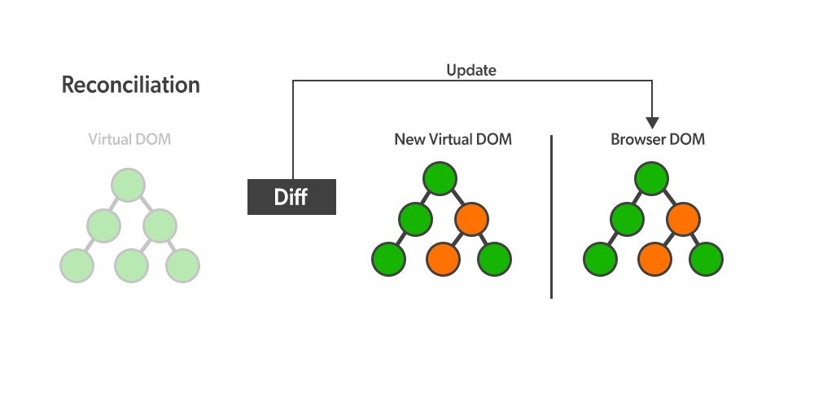
React Introduction
React Basics
What is React?
Static vs Dynamic HTML
React, sometimes referred to as a frontend JavaScript framework, is a JavaScript library created by Facebook.
React is a tool for building UI components.
How does React Work?
React creates a VIRTUAL DOM in memory.
React only changes what needs to be changed!
React.JS History
Current version of React.JS is V18.0.0 (April 2022).
Initial Release to the Public (V0.3.0) was in July 2013.

Slide 6
React Getting Started
React Basics
01-React Directly in HTML
02-Setting up a React Environment
If you have npx and Node.js installed, you can create a React application by using create-react-app.
npx create-react-app my-react-app
Run the React Application
Run this command to run the React application my-react-app:
npm start
React ES6

Slide 7
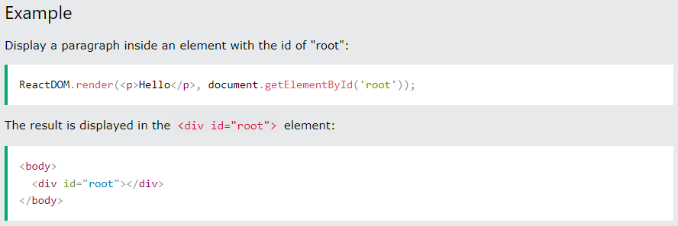
React Render HTML
React Basics
The Render Function
React renders HTML to the web page by using a function called ReactDOM.render().
The ReactDOM.render() function takes two arguments, HTML code and an HTML element.

Slide 8
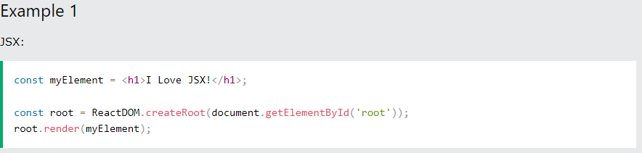
React JSX
React Basics
What is JSX?
JSX stands for JavaScript XML.
JSX allows us to write HTML elements in JavaScript and place them in the DOM without any createElement() and/or appendChild() methods.
JSX follows XML rules, and therefore HTML elements must be properly closed.

Slide 9
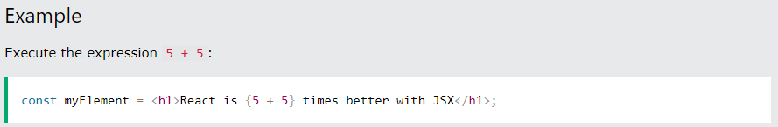
React JSX
React Basics
Expressions in JSX
With JSX you can write expressions inside curly braces { }.
The expression can be a React variable, or property, or any other valid JavaScript expression. JSX will execute the expression and return the result:

Slide 10
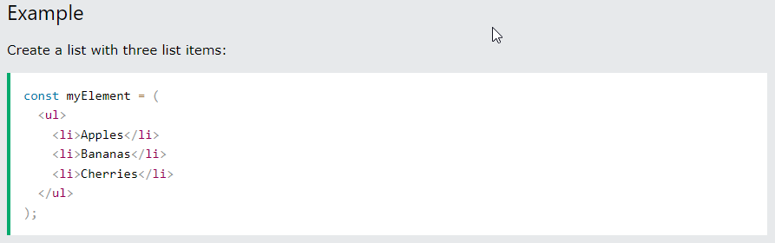
React JSX
React Basics
Inserting a Large Block of HTML in JSX
To write HTML on multiple lines, put the HTML inside parentheses ():

Slide 11
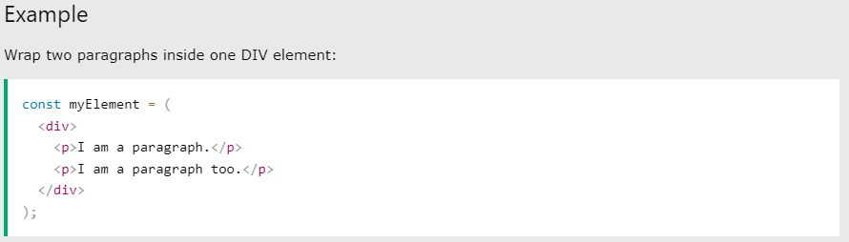
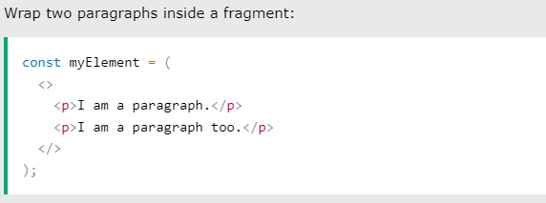
React JSX
React Basics
Inserting a Large Block of HTML in JSX
To write HTML on multiple lines, put the HTML inside parentheses ():
One Top-Level Element
The HTML code must be wrapped in ONE top-level element or fragment <></>.

Slide 12
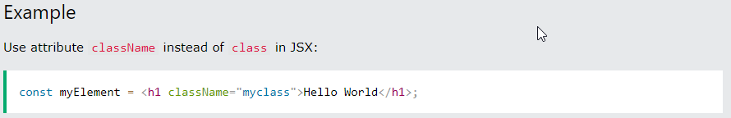
React JSX
React Basics
Inserting a Large Block of HTML in JSX
To write HTML on multiple lines, put the HTML inside parentheses ():
One Top-Level Element
The HTML code must be wrapped in ONE top-level element or fragment <></>.
Attribute class = className

Slide 13
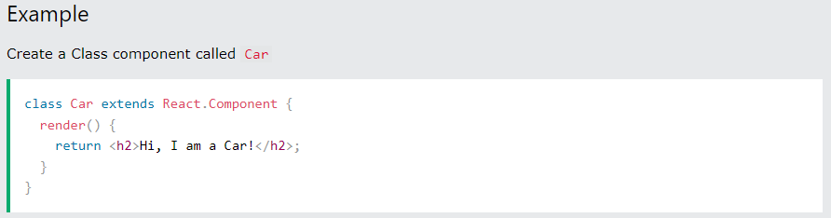
React Components
React Basics
What are React Components?
Components are like functions that return HTML elements.
Class components and Function components
Create Your First Component
The component's name MUST start with an upper case letter.
Class Component

Slide 14
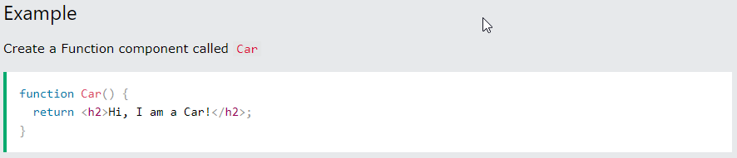
React Components
React Basics
What are React Components?
Components are like functions that return HTML elements.
Class components and Function components
Create Your First Component
The component's name MUST start with an upper case letter.
Class Component
Function Component

Slide 15
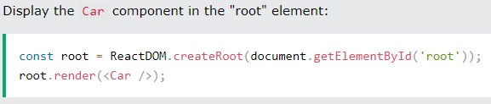
React Components
React Basics
What are React Components?
Components are like functions that return HTML elements.
Class components and Function components
Create Your First Component
Function Component
Rendering a Component

Slide 16
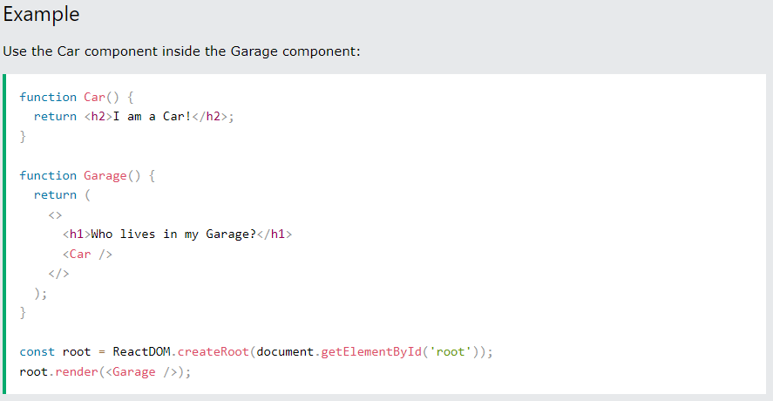
React Components
React Basics
Components in Components
We can refer to components inside other components:

Slide 17
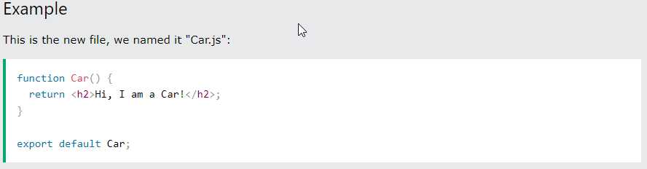
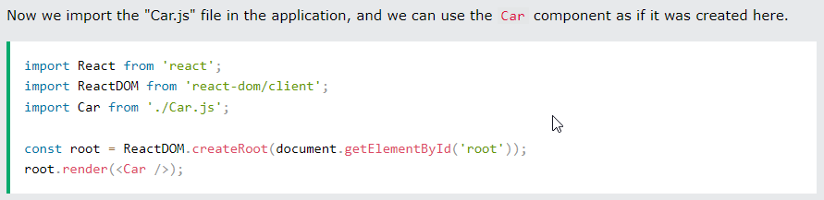
React Components
React Basics
Components in Files
React is all about re-using code, and it is recommended to split your components into separate files.
To do that, create a new file with a .js file extension and put the code inside it:
Note that the filename must start with an uppercase character.

Slide 18
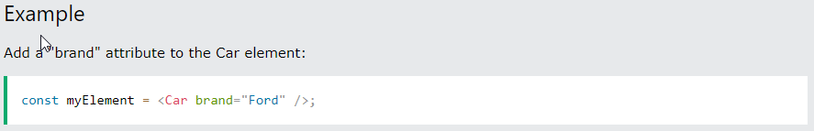
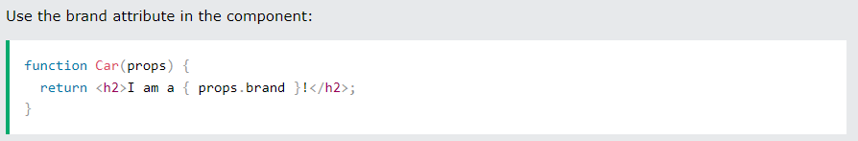
React Props
React Basics
What are React Props?
props stand for properties
React Props are like function arguments in JavaScript and attributes in HTML.
To send props into a component, use the same syntax as HTML attributes:
- The component receives the argument as a props object:

Slide 19
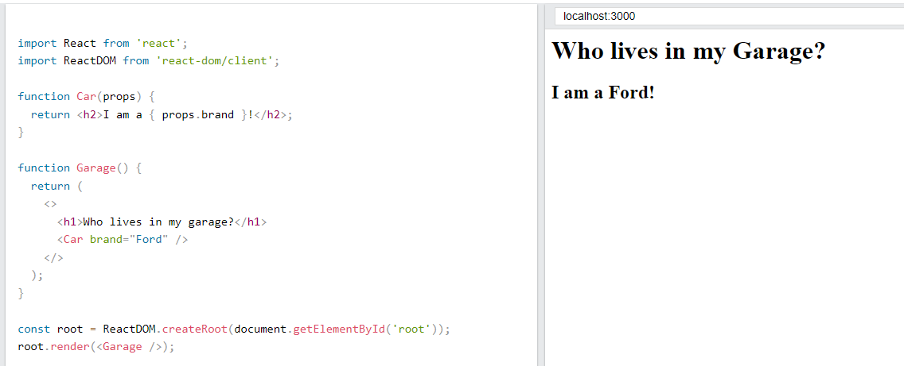

React Props
React Basics
Pass Data using React Props
React Props are like function arguments in JavaScript and attributes in HTML.
Props are also how you pass data from one component to another, as parameters.

Slide 20
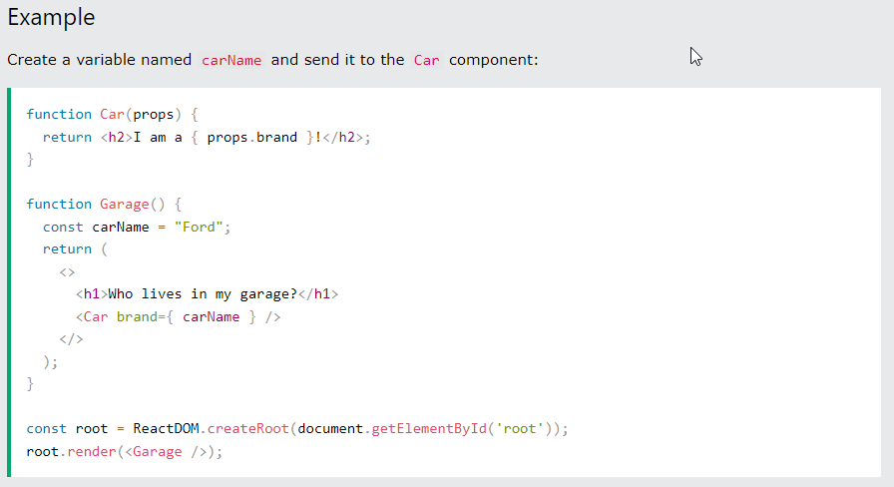
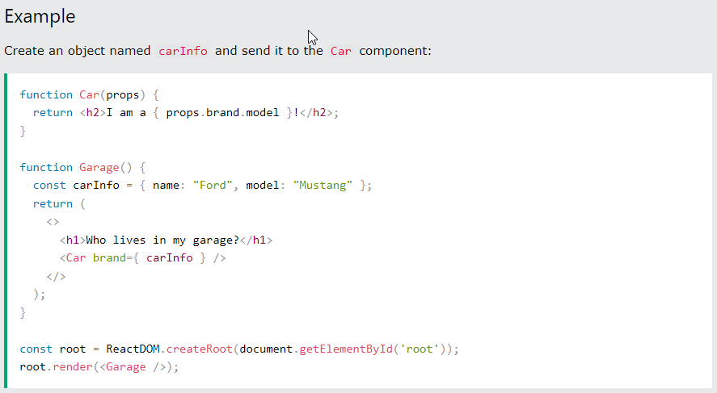
React Props
React Basics
Pass Data using React Props
If you have a variable/object to send and not a string, just put the variable/object name inside curly brackets {}:
Note: React Props are read-only! You will get an error if you try to change their value.

Slide 21
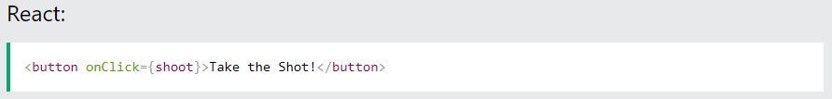
React Events
React Basics
What are React Events?
Just like HTML DOM events, React can perform actions based on user events.
React has the same events as HTML: click, change, mouseover etc.
Adding Events
React events are written in camelCase syntax:
onClick instead of onclick
React event handlers are written inside curly braces{}:
onClick={shoot} instead of onClick="shoot()"
Tryit Editor

Slide 22
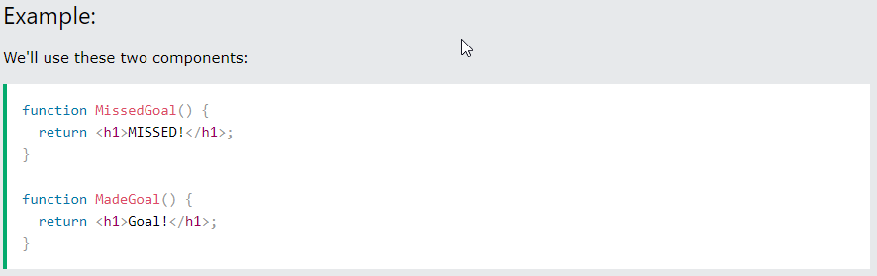
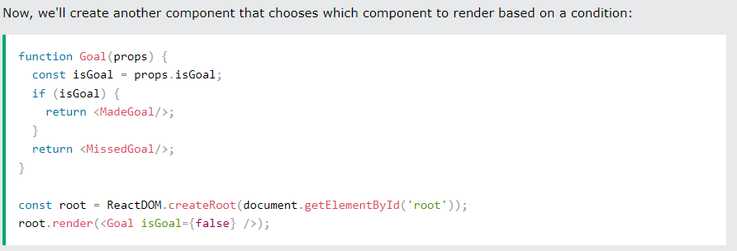
React Conditional Rendering
React Basics
In React, you can conditionally render components.
if Statement

Slide 23
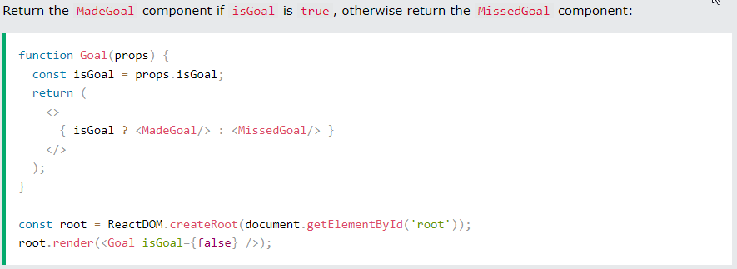
React Conditional Rendering
React Basics
In React, you can conditionally render components.
Ternary Operator
condition ? true : false

Slide 24
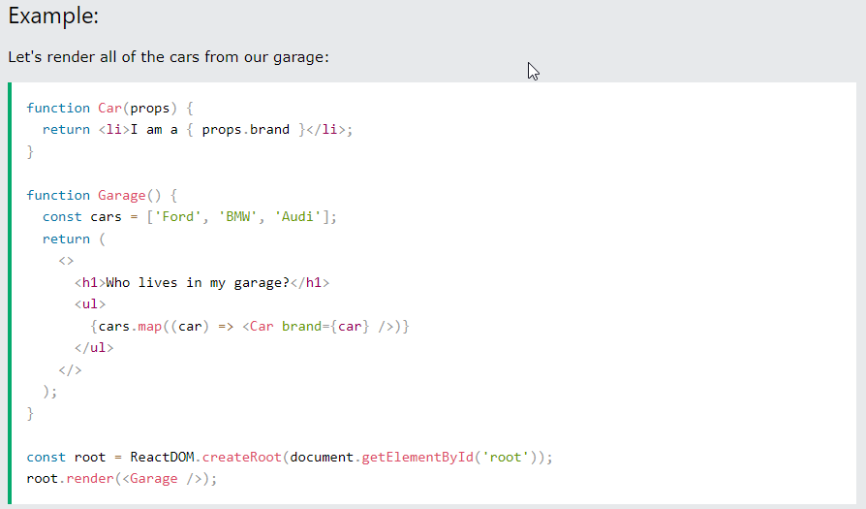
React Lists
React Basics
In React, you will render lists with some type of loop.
The JavaScript map() array method is generally the preferred method.

Slide 25
Styling React Using CSS
React Basics
There are many ways to style React with CSS, this tutorial will take a closer look at three common ways:
Inline styling
CSS stylesheets
CSS Modules
camelCased Property Names
Since the inline CSS is written in a JavaScript object, properties with hyphen separators, like background-color, must be written with camel case syntax:
Use backgroundColor instead of background-color

Slide 26
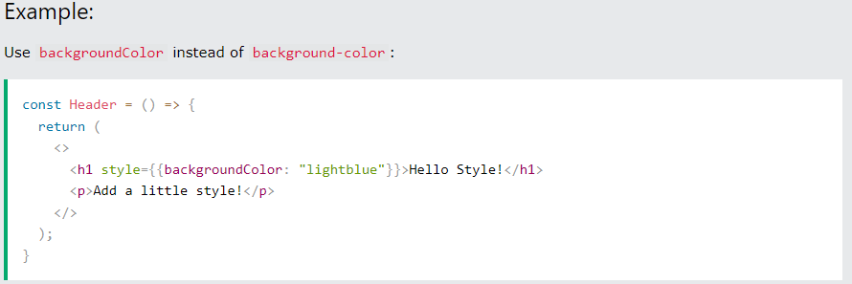
Styling React Using CSS
React Basics
Inline Styling
To style an element with the inline style attribute, the value must be a JavaScript object:
Note: In JSX, JavaScript expressions are written inside curly braces, and since JavaScript objects also use curly braces, the styling in the example above is written inside two sets of curly braces {{}}

Slide 27
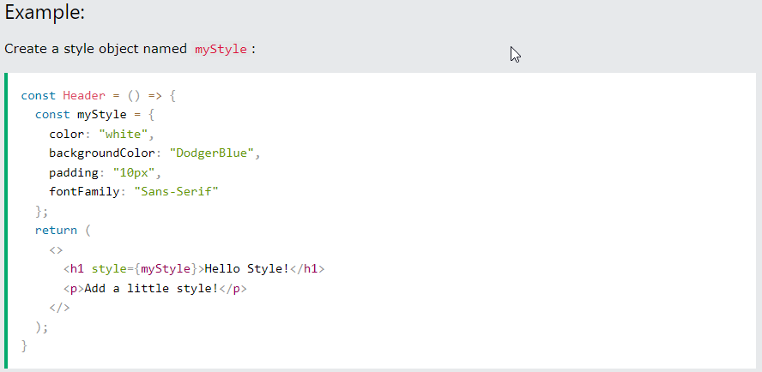
Styling React Using CSS
React Basics
Styling using JavaScript Object
You can also create an object with styling information, and refer to it in the style attribute:

Slide 28
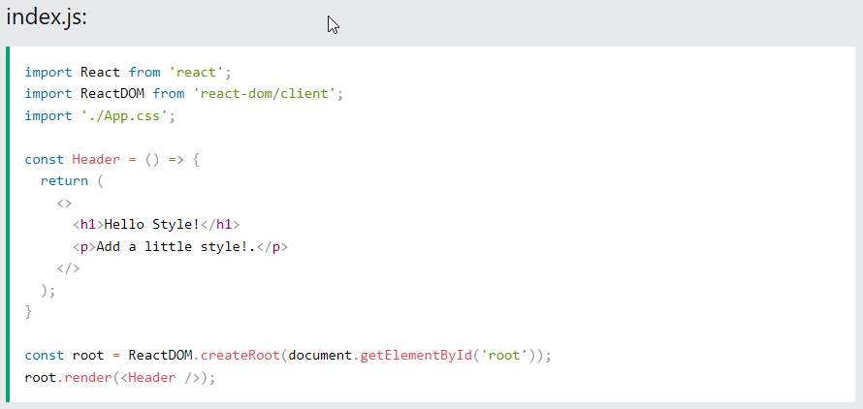
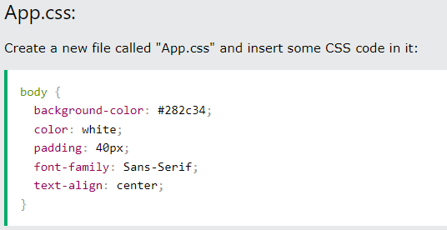
Styling React Using CSS
React Basics
CSS Stylesheet
You can write your CSS styling in a separate file, just save the file with the .css file extension and import it in your application.

Slide 29
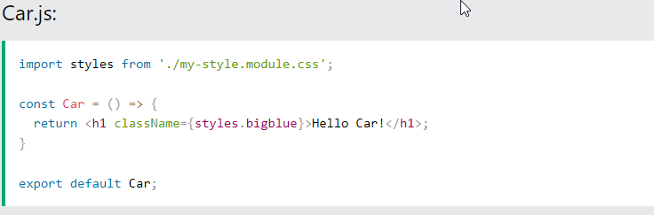
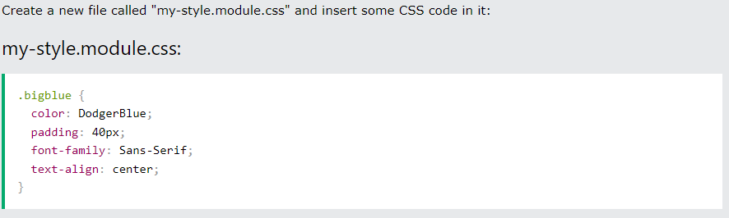
Styling React Using CSS
React Basics
CSS Modules
CSS Modules are convenient for components that are placed in separate files.
Create the CSS module with the .module.css extension, example: my-style.module.css.

Slide 30
Summary
Module 13
HTML Basics
Explaining Tagging concept
List creation and display
Divs and Spans creation
Attributes and information display

